Slide 1
8-bit Pipelined Picoblaze
NIKO NIKOLOV, AALAP KHANOLKAR, KATHYAYANI NEERUDI

Slide 2
Overview
Introduction
Block Diagram
Project Goals
Verification approach
Pipeline stages
Instruction fetch
Instruction decode
Execute
Memory access
Write back
Assertions
Bugs found
Challenges faced
Learnings
References

Slide 3
Introduction
Picoblaze is a Xilinx microcontroller
Used in many Xilinx FPGAs such as Series 7
Pacoblaze is RTL implementation of the Picoblaze ISA
Pipelined Picoblaze (RojoBlaze) is based on the Pacoblaze
Rojoblaze written by John Lynch and Roy Kravitz

Slide 4
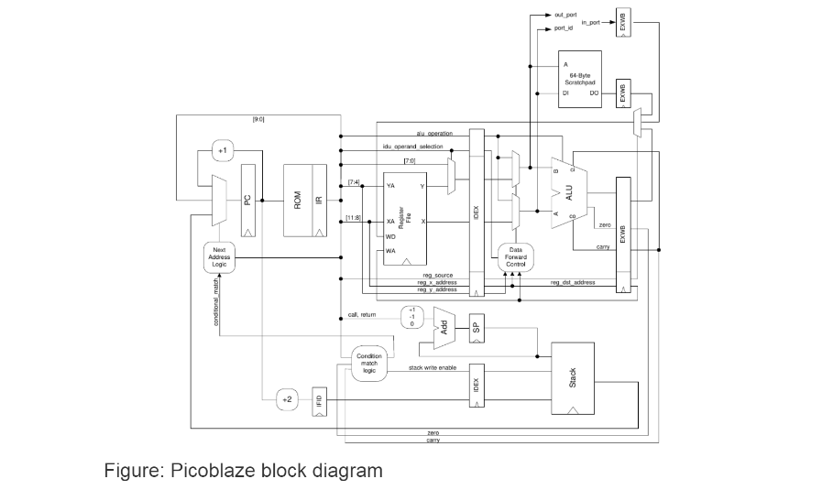
Picoblaze Block Diagram

Slide 5
Project Goals
Verify the pipelined Picoblaze RTL model
Understand Micro Controller functionality
Breakdown testing to different segments .i.e. Instructions and signal propagation
Test instructions behavior
Test signals propagation and timing
Writing test cases and assertions to find the bug in the code.

Slide 6
Verification Approach
Assembly code (.psm files) for the Picoblaze ISA
Unit tests for 5 pipeline stages (IF, ID, EX, MA, WB)
Generate .mem files using the Picoblaze assembler
Instantiate and run .mem files in the top level testbench as stimulus to the Picoblaze
Assertions have been used to text the bugs on every stage of the pipeline.
Every assertion is compared with the bugged and non-bugged (gold standard) code.
If a particular assertion is triggered

Slide 7
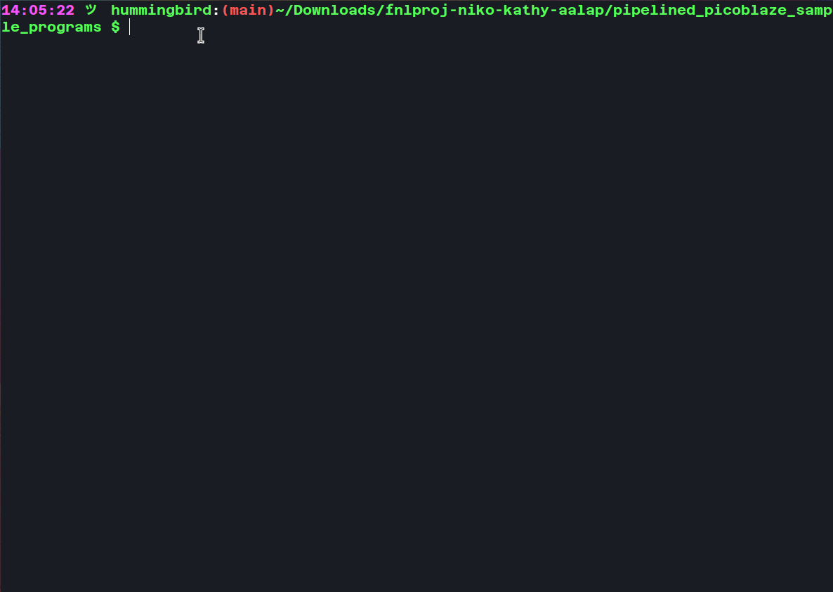
Using KCAsm

Slide 8
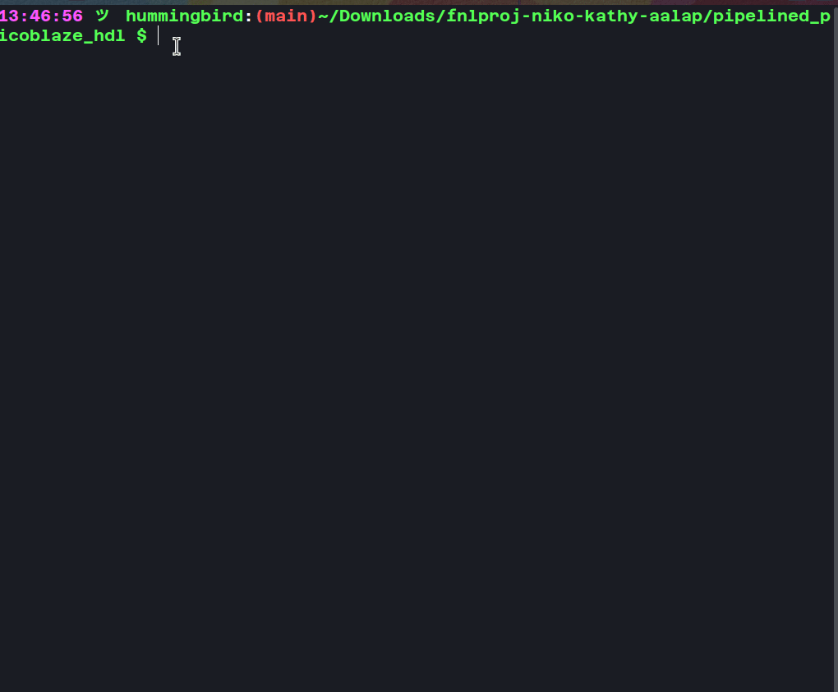
Compiling PicoBlaze psm

Slide 9
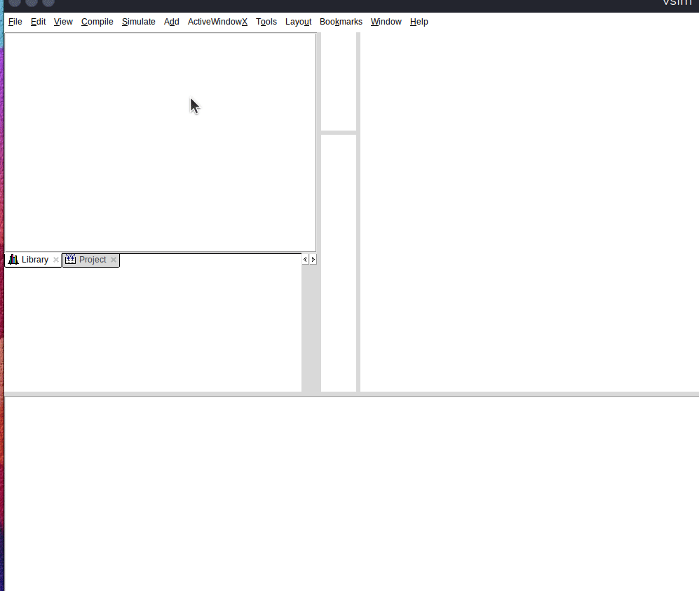
Simulating mem file in testbench

Slide 10
Demonstrating assertions in different pipeline stages
This architecture consists of 5 stages, namely-
Instruction Fetch
Instruction Decode
Instruction Execute
Memory Access
Write Back

Slide 11
Instruction Fetch
The instruction fetch unit fetches the instruction that is currently stored in the program counter. The assertions that we wrote are:
reset_check: checks if PC = zero when reset signal is asserted
rollover_check: Checks if PC rollover is working
pc_jump: Checks if PC is jumping to the target address

Slide 12
Instruction Decode
The decoding process allows the CPU to determine what instruction is to be performed so that the CPU can tell how many operands it needs to fetch in order to perform the instruction. The assertions that we wrote were as follows:
Testing the validity of the instructions (Error if the instruction is invalid)
Checking the ZERO flag
Checking the CARRY flag.

Slide 13
Instruction Execution
Validate ALU operations such as ADD and SUB
Validate the ZERO flag is asserted correctly
Validate the CARRY flag is asserted correctly
Validate the Carry Flag is cleared correctly
Validate the shift_bit is asserted correctly
Validate write and read strobe
Validate scratch write enable
Validate register write enable
Validate ALU operand_a and operand_b are correctly asserted

Slide 14
Memory Access
In this segment the primary thing that we want to test is whether we are accessing the memory in the correctly.
The assertions that we wrote to test the following were:
To ensure correct memory access, check we set an assertion to check the Scratchpad boundary
Check Scratch Write gets asserted after STORE
Check Register Write gets asserted during STORE
Check WR Strobe gets asserted when writing to Scratch Register

Slide 15
Memory Writeback
Validate in_port contains the correct value before writing
Validate reg_source contains is asserted correctly to multiplex the WB
Validate dist contains the correct register value
Validate X and Y addresses are populated correctly
Validate X and Y match operand_a and operand_b
Validate if STORE bits [3:0] are zero

Slide 16
Bugs Found
ALU not setting the Zero Flag
ALU not performing correctly ADD and SUB
ALU not setting the Carry Flag correctly
STORE not storing the data in the scratchpad due to decrementing incorrectly and ALU wrong Address calculation (later we were explained it was due to the stack pointer)

Slide 17
Challenges Encountered
PicoBlaze architecture and its functioning was difficult to understand.
Eliminating false positives from with the assertions was also a crucial step.
Coordinating remotely
Given the limited amount of time it was difficult to decide what we should test first
CAT infrastructure goes down or slows down often

Slide 18
Learnings
We got to work collectively in the github classroom version control environment.
Working together remotely, exchanging ideas and collaborating helped all three of us to get better insights of the PicoBlaze, writing the test cases and assertions.
Timing is literally everything when it comes to digital design and testing

Slide 19
Given more time, what we would do differently...
Review more functionalities and write higher level tests/assertions
Drill down to timings and signal level testing, to ensure signals propagate based on the spec defined timing and get asserted correctly
Write tests for stack pointer
Instead of having the assertions in the test bench we would have created a separate file for that, even better separate the assertions
We would have created an interface that connects all signals, instead of hacking the signals through their module names. That would have been a much cleaner approach

Slide 20
References Used
Sutherland, S. (2017). RTL Modeling with SystemVerilog for Simulation and Synthesis using SystemVerilog for ASIC and FPGA design. Sutherland HDL, Inc.
Mehta, A. (2016). SystemVerilog Assertions and Functional Coverage Guide to Language, Methodology and Applications. Springer International Publishing AG Switzerland.
Taraate, V. (2020). SystemVerilog for Hardware Description RTL Design and Verification. Springer.
Chapman, K. (2003). Picoblaze KCPSM3 8-bit Micro Controller for Spartan-3, Virtex-II and Virtex-IIPRO. Xilinx Ltd.
Herriman, A., & Blanchard, E. (2006). PacoBlaze. Xilinx Ltd.
Chapman, K. (2005). PicoBlaze 8-bit Embedded Microcontroller User Guide for Spartan-3, Virtex-II, and Virtex-II Pro FPGAs. Xilinx.

